Slide 1

Project Title - Seasonal Agriculture Performance Analysis
AICTE Student ID: STU6a59002fa26dd1784217647
Student Name: Sudhanshu Tripathi

Slide 2

PROBLEM STATEMENT
Agricultural activities are influenced by seasonal variations in environmental conditions, farming practices, resource availability and market conditions. As a result, agricultural performance may differ from one season to another. However, raw agricultural data does not clearly explain how agricultural performance changes across seasons or what patterns can be observed in different seasonal conditions. The problem is to analyze the given agricultural dataset and investigate seasonal differences in agricultural performance by identifying meaningful patterns, trends, relationships and variations within the available data.

Slide 3
Project Description
Conducted an end-to-end data analytics lifecycle on a 4,000-record agricultural dataset to uncover seasonal performance trends.
Performed rigorous Data Preprocessing, handling missing values via median imputation and eliminating extreme outliers using the Interquartile Range (IQR) method.
Executed Univariate, Bivariate, and Multivariate analyses to map the complex relationships between environmental factors (Rainfall, Temperature) and economic outcomes (Profit, Revenue).
Delivered data-driven recommendations to optimize resource usage (like water and pesticides) and maximize farmer profitability across Kharif, Rabi, and Zaid seasons.

Slide 4

WHO ARE THE END USERS?
Farmers & Local Agronomists: To make data-backed decisions on crop selection based on regional rainfall zones and to understand the economic risks of off-season (Zaid) farming.
Agri-Tech Companies & Planners: To identify patterns of severe resource over-consumption (e.g., massive water usage outliers) and target areas for deploying smart irrigation systems.
Government Policymakers: To recognize regional economic disparities and optimize the distribution of subsidies for pesticides and fertilizers where they are most effective.

Slide 5

Technology Used
Programming Language: Python 3
Data Manipulation & Cleaning: Pandas, NumPy
Data Visualization: Matplotlib, Seaborn
Environment / IDE: Google Colab / Jupyter Notebook

Slide 6
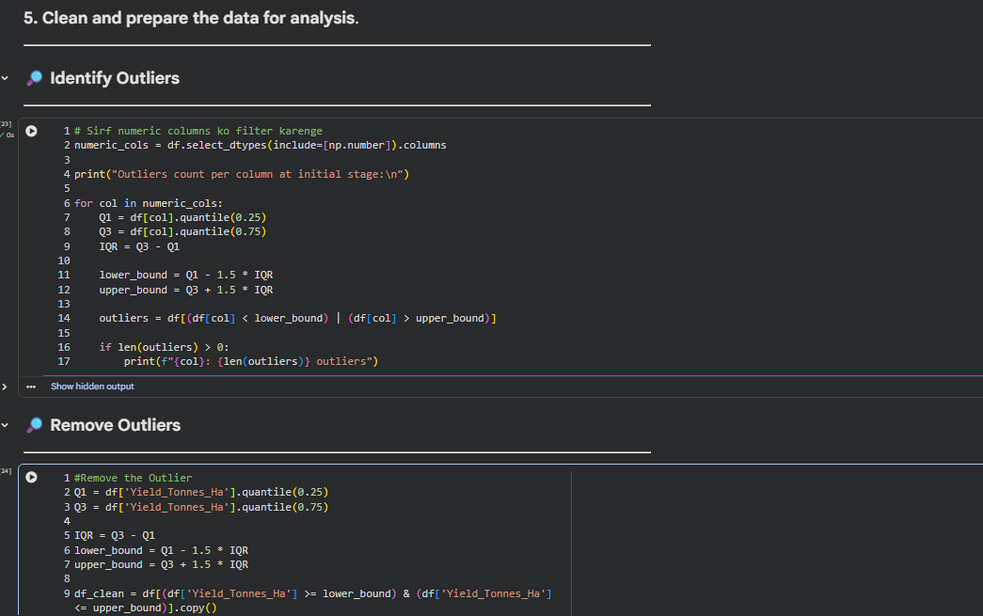
RESULTS
📌 Data Cleaning
Robust Data Preprocessing: Implemented the Interquartile Range (IQR) method to identify and remove extreme, unrealistic anomalies (e.g., Yield spikes of 100+ tonnes).
Ensuring Accuracy: This critical step prevents skewed visualizations and guarantees that our economic averages (Profit/Revenue) reflect true ground realities.

Slide 7
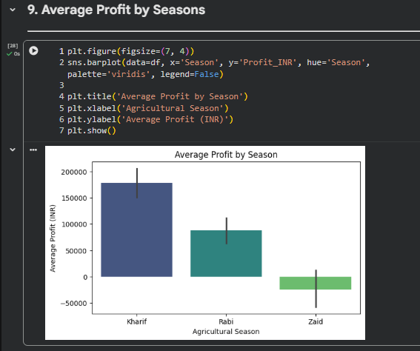
RESULTS
📌 Seasonal Performance
Kharif Dominance: The data clearly establishes the Kharif season as the primary economic driver, consistently yielding the highest average profit.
The Zaid Risk: The Zaid (summer) season displays the lowest financial returns, with error bars indicating a high probability of negative profit (financial loss).

Slide 8
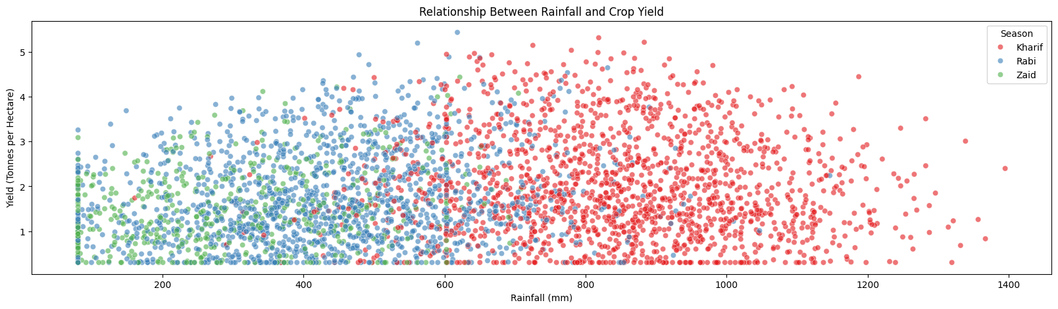
RESULTS
📌 Environmental Dependency
Strict Climatic Boundaries: Revealed that Kharif crops are strictly dependent on high-rainfall zones (600mm - 1400mm), while Rabi thrives in lower rainfall conditions.
Input vs. Output Limit: The plot shows that yield hits a ceiling (around 5-6 tonnes) regardless of excess rainfall, proving that simply adding more water does not guarantee more harvest.

Slide 9
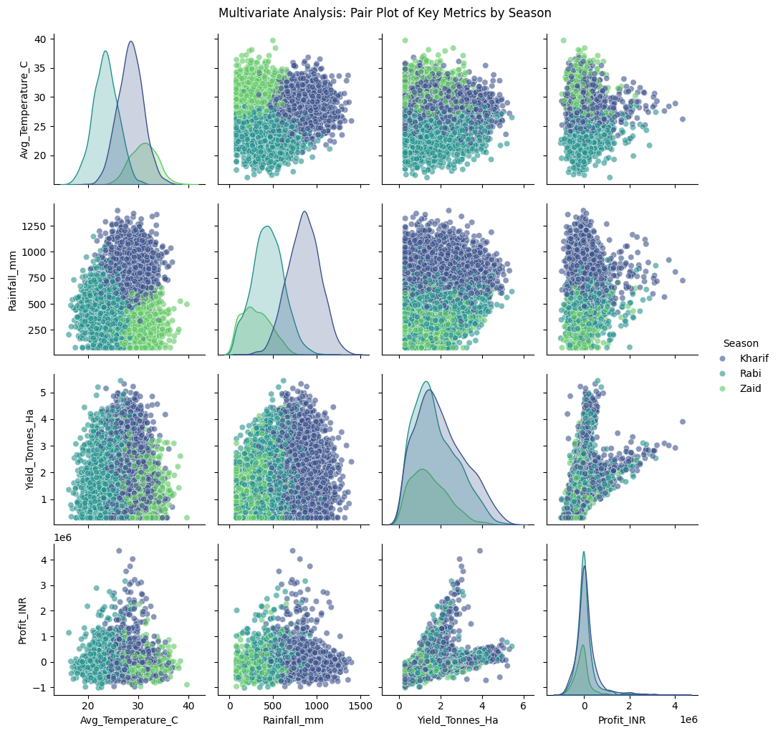
RESULTS
📌 Multivariate Analysis
Multi-dimensional Clustering: The pairplot proves that each agricultural season operates within its own distinct, non-overlapping environmental identity (Temperature and Rainfall combinations).
Scaling Profitability: The steep upward trend in the 'Yield vs. Profit' grid highlights how rapidly Kharif profits scale up compared to other seasons as production increases.

Slide 10
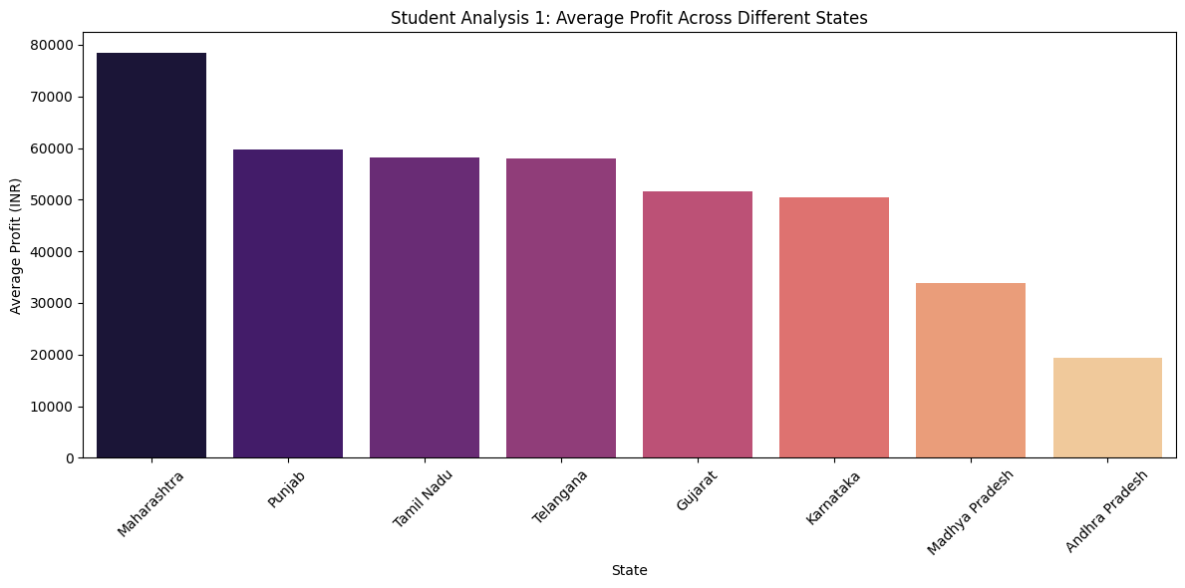
RESULTS
📌 Student-Driven Analysis
Geographical Variance: Uncovered stark regional economic disparities, with states like Maharashtra and Punjab significantly outperforming the national average.
Actionable Targeting: This insight allows policymakers and agri-tech firms to identify underperforming regions (like Andhra Pradesh) for targeted interventions and resource subsidies.

Slide 11
Future scope
Integration of Environmental Impact Data: Expanding the dataset to include soil health degradation and chemical residue metrics to study the long-term negative externalities (e.g., human disease risks) of high pesticide usage.
Predictive Machine Learning Modeling: Transitioning from descriptive analytics to predictive modeling by using algorithms like Random Forest to forecast crop yields based on upcoming weather patterns.
Cost Component Breakdown: Analyzing detailed cost variables (seeds, labor, equipment) to pinpoint exactly where farmers are losing their profit margins despite high revenues.

Slide 12
GitHub Link
https://github.com/hey-Sudhanshu07/VOIS-Edunet-Internship/tree/main/Major%20Project%3A%20Seasonal_Agriculture_Analysis

Slide 13

VOIS Course completion certificate - Course name- Data Visualization

Slide 14
Thank you
.
.

